Slide 1
Browser Objects
Window Object

Slide 2
What is BOM
The collection of objects that the browser makes available to you for use with JavaScript is generally called the Browser Object Model (BOM).

Slide 3
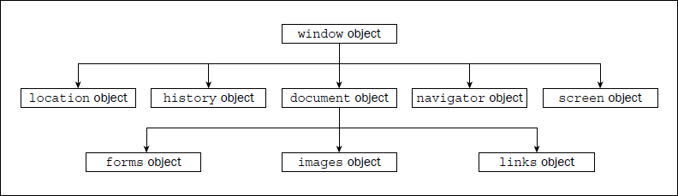
Window Object

Slide 4
The BOM has a hierarchy. At the very top of this hierarchy is the window object.
You can think of this as representing the frame of the browser and everything associated with it, such as the scrollbars, navigator bar icons, and so on.
Contained inside our window frame is the page. The page is represented in the BOM by the document object. You can see these two objects represented in figure:

Slide 5
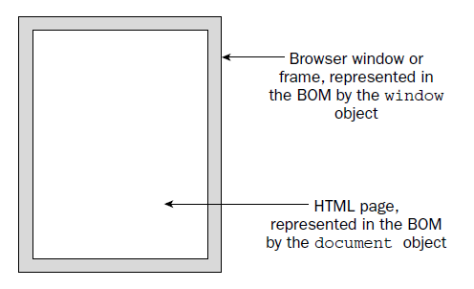

Slide 6
The window Object—Our Window onto the Page
The window object represents the browser’s frame or window, in which your web page is contained.
To some extent, it also represents the browser itself and includes a number of properties that are there simply because they don’t fit anywhere else.
For example, via the properties of the window object, you can find out what browser is running, the pages the user has visited, the size of the browser window, the size of the user’s screen, and much more.
You can also use the window object to access and change the text in the browser’s status bar, change the page that is loaded, and even open new windows.

Slide 7
The window object is a global object, which means you don’t need to use its name to access its properties and methods.
In fact, the global functions and variables (the ones accessible to script anywhere in a page) are all created as properties of the global object.
For example, the alert() function you have been using is the alert() method of the window object.

Slide 8
Some of the properties of the window object are themselves objects. Those common to both IE and NN include the:
Document (represents your page),
Navigator (holds information about the browser),
History (contains the history of pages visited by the user),
Screen (contains information about the display capabilities of the client), and
Location (contains details on the current page’s location) objects

Slide 9
Using the window Object
Change default status
On IE and Firefox, after a document has loaded, you’ll normally see Done in the status bar. Let’s change that so it says Hello and Welcome.
To change the default message in the window’s status bar, you need to use the window object’s defaultStatus property.
To do this you can write the following:
window.defaultStatus = "Hello and Welcome";
Or, because the window is the global object, you can just write this:
defaultStatus = "Hello and Welcome";

Slide 10
<html>
<head>
<script language="JavaScript" type="text/javaScript">
window.defaultStatus = "Hello and Welcome";
</script>
</head>
</html>

Slide 11
History Object

Slide 12
The history Object
The history object keeps track of each page that the user visits.
This list of pages is commonly called the history stack for the browser. It enables the user to click the browser’s Back and Forward buttons to revisit pages. You have access to this object via the window object’s history property.
Like the native JavaScript Array object, the history object has a length property. You can use this to find out how many pages are in the history stack.

Slide 13
The history object has the back() and forward() methods. When they are called, the location of the page currently loaded in the browser is changed to the previous or next page that the user has visited.
The history object also has the go() method. This takes one parameter that specifies how far forward or backward in the history stack you want to go.

Slide 14
For example, if you wanted to return the user to the page before the previous page, you’d write this:
history.go(-2);
To go forward three pages, you’d write this:
history.go(3);
Note that go(-1) and back() are equivalent, as are go(1) and forward().

Slide 15
Location Object

Slide 16
The location Object
The location object contains lots of potentially useful information about the current page’s location.
Not only does it contain the URL (Uniform Resource Locator) for the page, but also the server hosting the page, the port number of the server connection, and the protocol used.
This information is made available through the location object’s href, hostname, port, and protocol properties.
However, many of these values are only really relevant when you are loading the page from a server and not loading the page directly from a local hard drive.

Slide 17
You can also use the methods of the location object to change the location and refresh the current page.
You can navigate to another page in two ways. You can either set the location object’s href property to point to another page, or you can use the location object’s replace() method.
replace() method removes the current page from the history stack and replaces it with the new page you are moving to. (can NOT go Back)
href property simply adds the new page to the top of the history stack. (can go Back)

Slide 18
For example, to replace the current page with a new page called myPage.htm
window.location.replace("myPage.htm");
Or
window.location.href = "myPage.htm";

Slide 19
Navigator Object

Slide 20
The navigator Object
The navigator object is another object that is a property of the window object and is available in both IE and Firefox browsers.
Its name is more historical than descriptive. Perhaps a better name would be the "browser object," because the navigator object contains lots of information about the browser and the operating system in which it’s running.

Slide 21
Probably the most common use of the navigator object is for handling browser differences.
Using its properties, you can find out which browser, version, and operating system the user has.
You can then act on that information and make sure the user is directed to pages that will work with his browser.

Slide 22
Screen Object

Slide 23
The screen Object
The screen object property of the window object contains a lot of information about the display capabilities of the client machine.
Its properties include the height and width properties, which indicate the vertical and horizontal range of the screen in pixels.
Another property of the screen object is the colorDepth property. This tells you the number of bits used for colors on the client’s screen.

Slide 24
Document Object

Slide 25
The document Object—The Page Itself
Along with the window object, the document object is probably one of the most important and commonly used objects in the BOM.
Via this object you can gain access to the properties and methods of some of the objects defined by HTML tags inside your page.

Slide 26
BOMs of different browsers can differ greatly. We will concentrate on those properties and methods of the document object that are common to all browsers.
The document object has a number of properties associated with it, which are also arrays. The main ones are the forms, images, and links arrays.

Slide 27
Using the document Object
Set the background color of the page according to how many colors the user’s screen supports. This is termed screen color depth. If the user has a display that supports just two colors (black and white), there’s no point in you setting the background color to bright red. You accommodate different depths by using JavaScript to set a color the user can actually see.

Slide 28
<html>
<body>
<script language="JavaScript" type="text/javaScript">
switch (window.screen.colorDepth){
case 1:
case 4:
document.bgColor = "white";
break;
case 8:
case 15:
case 16:
document.bgColor = "blue";
break;
case 24:
case 32:
document.bgColor = "skyblue";
break;
default:
document.bgColor = "white";
}
document.write("Your screen supports " + window.screen.colorDepth + "bit color");
</script></body></html>
When you load it into your browser, the background color of the page will be determined by your current screen color depth. Also, a message in the page will tell you what the color depth currently is.

Slide 29
How It Works
As you saw earlier, the window object has the screen object property. One of the properties of this object is the colorDepth property, which returns a value of 1, 4, 8, 15, 16, 24, or 32. This represents the number of bits assigned to each pixel on your screen. (A pixel is just one of the many dots that your screen is made up of.)
To work out how many colors you have, you just calculate the value of 2 to the power of the colorDepth property. For example, a colorDepth of 1 means that there are two colors available, a colorDepth of 8 means that there are 256 colors available, and so on. Currently, most people have a screen color depth of at least 8, but usually of 16 or 24, with 32 increasingly common.

Slide 30
The images Array
As you know, you can insert an image into an HTML page using the following tag:
<img alt=”USA” name=myImage src=”usa.gif”>
The browser makes this image available for you to script in JavaScript by creating an img object for it with the name myImage.
In fact, each image on your page has an img object created for it.
Each of the img objects in a page is stored in the images[] array. This array is a property of the document object. The first image on the page is found in the element document.images[0], the second in document.images[1], and so on.

Slide 31
You can assign a variable to reference an img object in the images[] array. It can make code easier to read. For example, if you write
var myImage2 = document.images[1];
the myImage2 variable will contain a reference to the img object inside the images[] array at index position 1. Now you can write myImage2 instead of document.images[1] in your code, with exactly the same effect.

Slide 32
You can also access img objects in the images array by name. For example, the img object created by the <img> tag, which has the name myImage, can be accessed in the document object’s images array property like this:
document.images[“myImage”]
Because the document.images property is an array, it has the properties of the native JavaScript Array object, such as the length property. For example, if you want to know how many images there are on the page, the code document.images.length will tell you.

Slide 33
The img object itself has a number of useful properties. The most important of these is its src property. By changing this you can change the image that’s loaded. The next example demonstrates this.
<html>
<body>
<img name=img1 src="" border=0 width=300 height=250>
<script language="JavaScript" type="text/javaScript">
var myImages = new Array("dom-1.png","dom-2.png","dom-3.png");
var imgIndex = prompt("Enter a number from 0 to 2","1");
document.images["img1"].src = myImages[imgIndex];
</script>
</body>
</html>

